Slide 1
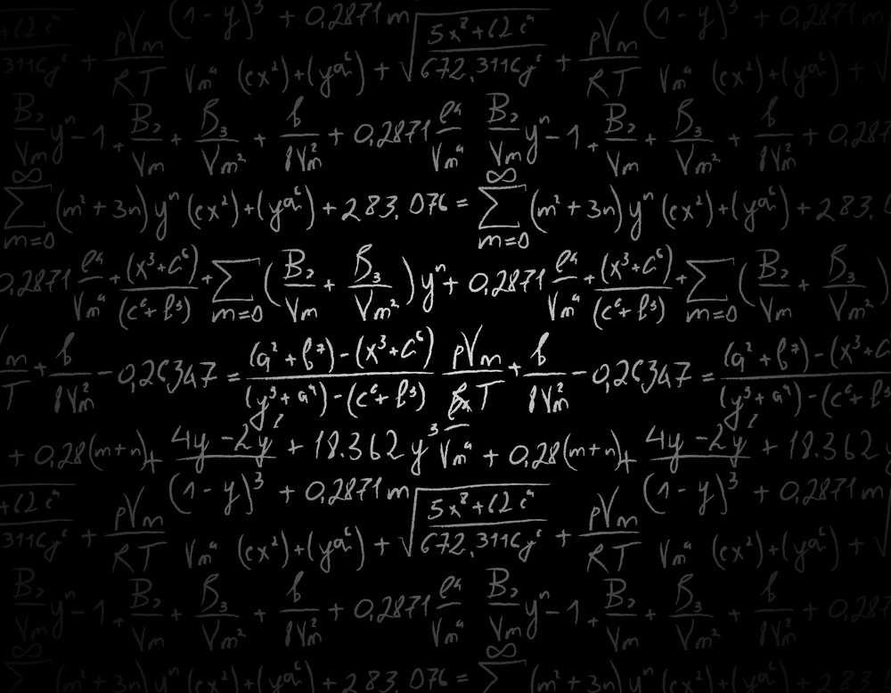
HANDWRITTEN EQUATION SOLVER USING CNN
NAME – PRAJWAL J

Slide 2
OUTLINE
INTRODUCTION
OBJECTIVE
METHODOLOGY
WORK DONE
WORK REMAINING
RESULTS

Slide 3
INTRODUCTION
We come across mathematical equations in almost all streams of science and engineering and also in some streams of commerce.
Inputting mathematical equations to electronic gadgets is very difficult and time consuming because a mathematical expression may contain special symbols, Latin or Greek letters and different operators along with numbers.
In this project we develop a system that recognizes a mathematical expression from handwriting and solves them.

Slide 4
DATASET
https://www.kaggle.com/xainano/handwrittenmathsymbols
Data set is extracted from here

Slide 5
OBJECTIVE
Training:
Generate a CNN model
Train the model with the Dataset
Evaluate and Save the model into a file
Testing
Open the saved model and the test image
Identify the parts in the image that comprises the equation
Convert the equation in the image into the string form
Evaluate the equation in string format and output the result.

Slide 6
What is neural network?
CNN is a supervised deep learning method. The origin of the applications of deep learning to object recognition tasks can be traced to the convolutional neural networks (CNNs) in the early 90s.
The CNN based architectures have captured intense interest in computer vision since October 2012 shortly after the ImageNet competition results were released.
They are made up of neurons that have learnable weights and biases.
Each neuron receives some inputs, performs a dot product and optionally follows it with a nonlinearity.
Their connectivity is now restricted to be local spatially.

Slide 7
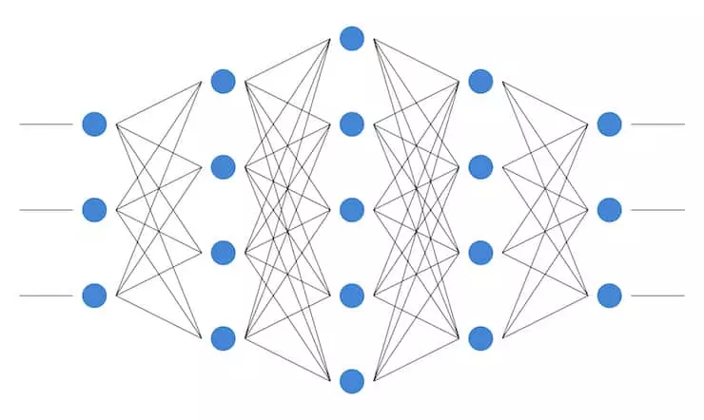
The leftmost layer in this network is called input layers and the neurons within the layer is called input neurons
The middle layer is called the hidden layer and the rightmost part in this network is called the output layer and the neurons within the layer is called output neurons.

Slide 8
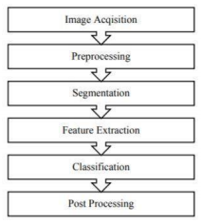
METHODOLOGY

Slide 9
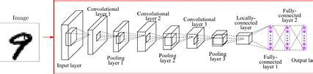
CNN ARCHITECTURE

Slide 10
Layers of CNN
Convolutional Layer This layer gets the effects of the neuron layer that is linked to the enter regions. The wide variety of filters to be used in this layer is described here. Each filter may additionally be a 5x5 window that slider over the input records and receives the pixel with the most intensity as the output.
Pooling Layer Down-sampling operation along the spatial dimensions (width, height), resulting in volume is utilized in this layer.

Slide 11
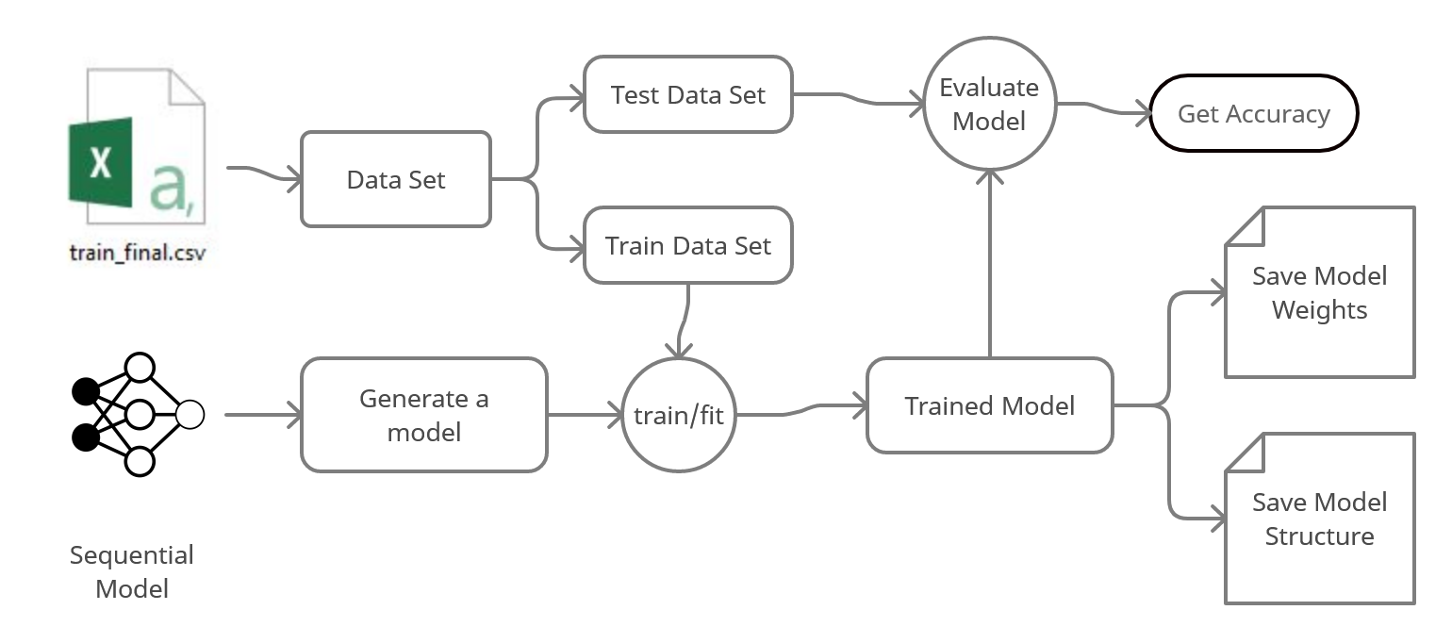
TRAIN FLOWCHART

Slide 12
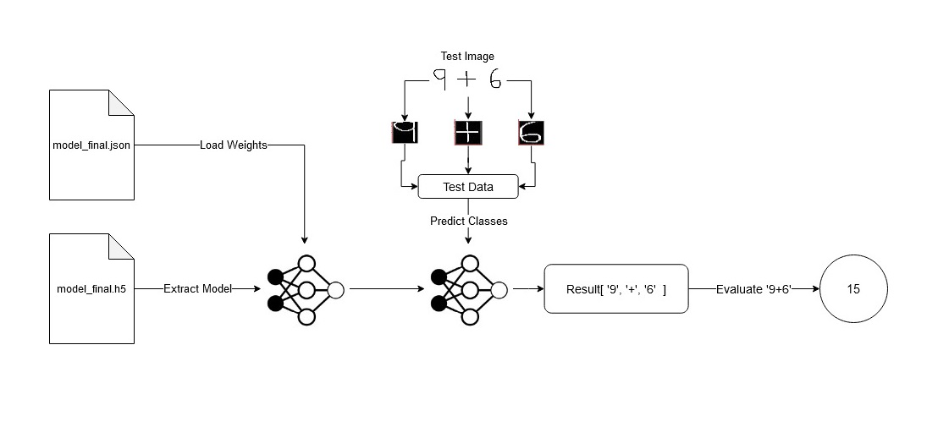
CNN FLOWCHART

Slide 13
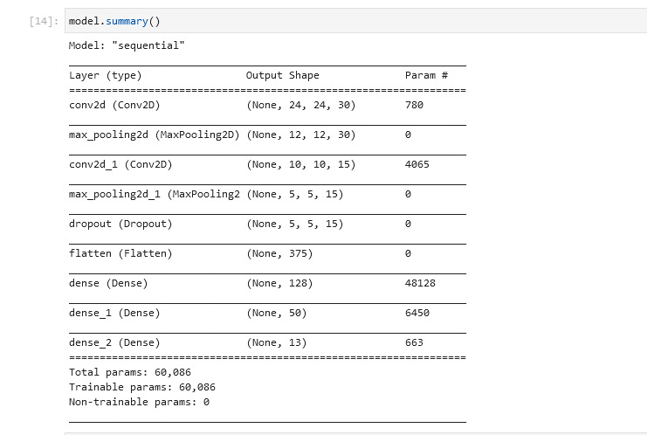
MODEL SUMMARY

Slide 14
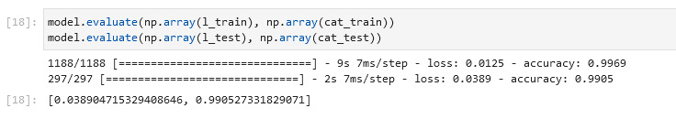
Results
Training Evaluation:

Slide 15
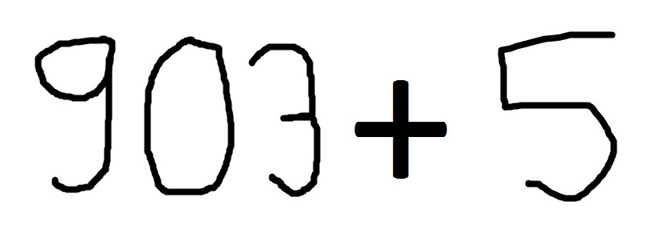




Results
Example 1

Slide 16
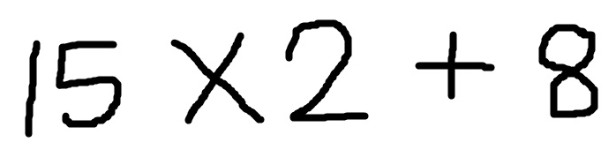



Results
Example 2

